Slide 1
Address Space Management
Scaling the Network
with NAT and PAT

Slide 2
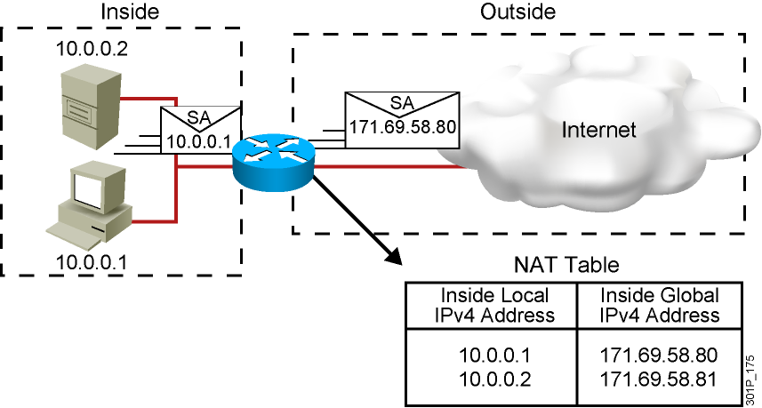
Network Address Translation
An IP address is either local or global.
Local IPv4 addresses are seen in the inside network.
Global IPv4 addresses are seen in the outside network.

Slide 3
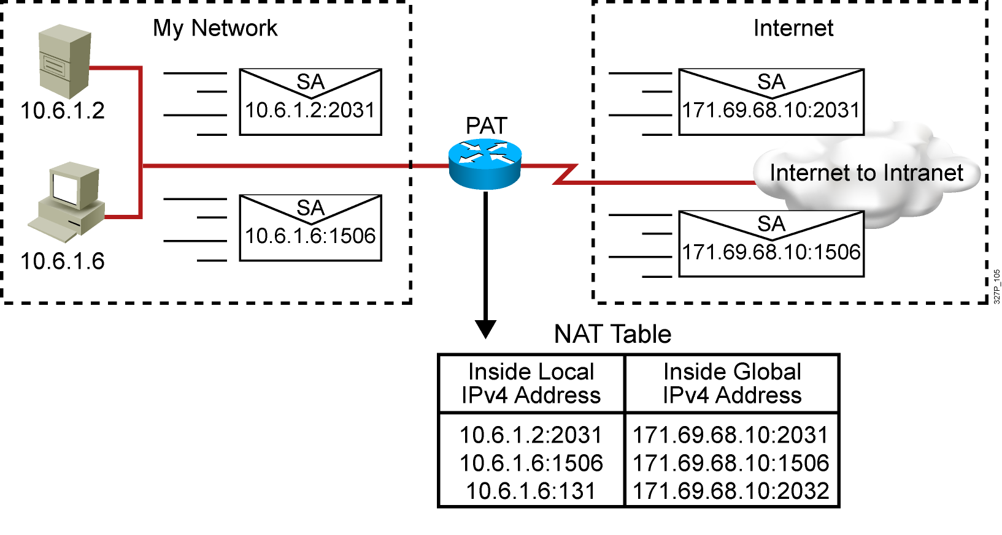
Port Address Translation

Slide 4
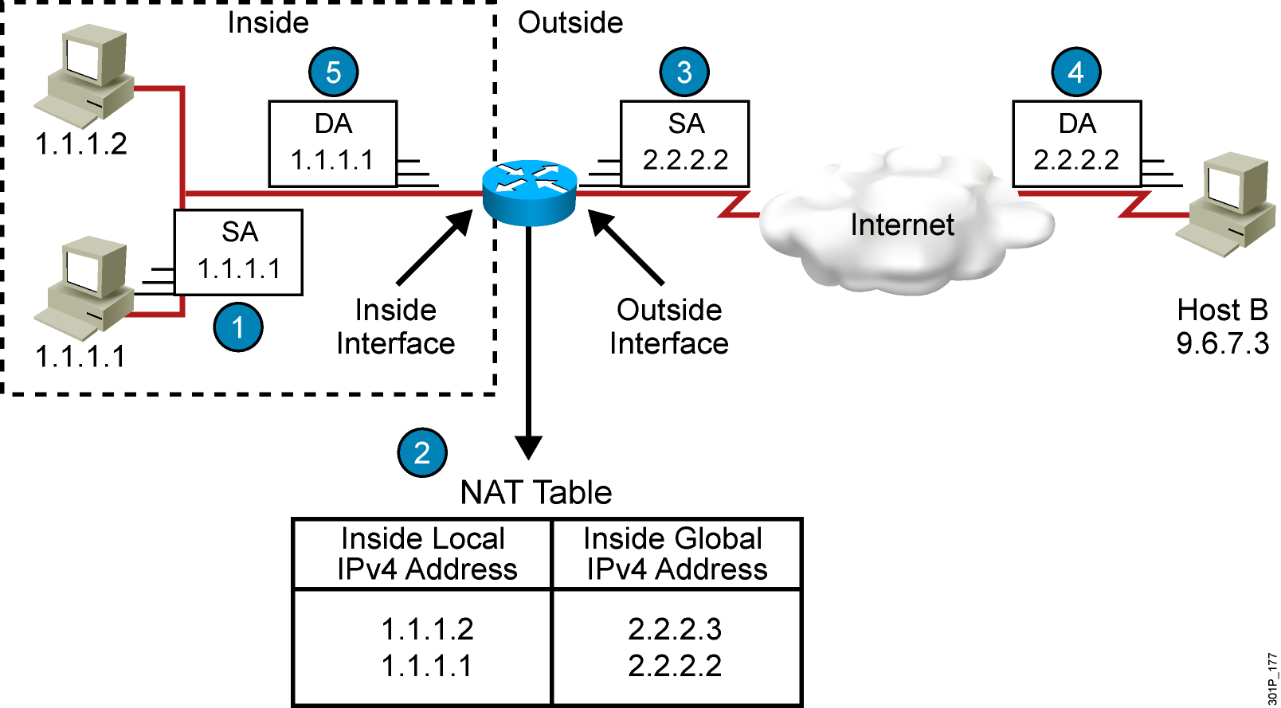
Translating Inside Source Addresses

Slide 5
Configuring and Verifying Static Translation
RouterX(config)# ip nat inside source static local-ip global-ip
Establishes static translation between an inside local address and an
inside global address
RouterX(config-if)# ip nat inside
Marks the interface as connected to the inside
RouterX(config-if)# ip nat outside
Marks the interface as connected to the outside
RouterX# show ip nat translations
Displays active translations

Slide 6
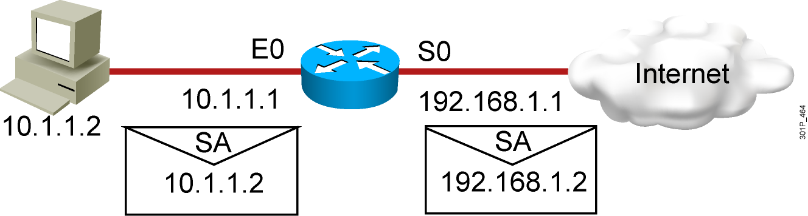
Enabling Static NAT
Address Mapping Example
interface s0
ip address 192.168.1.1 255.255.255.0
ip nat outside
!
interface e0
ip address 10.1.1.1 255.255.255.0
ip nat inside
!
ip nat inside source static 10.1.1.2 192.168.1.2
RouterX# show ip nat translations
Pro Inside global Inside local Outside local Outside global
--- 192.168.1.2 10.1.1.2 --- ---

Slide 7
Configuring and Verifying Dynamic Translation
RouterX(config)# ip nat pool name start-ip end-ip
{netmask netmask | prefix-length prefix-length}
Defines a pool of global addresses to be allocated as needed
RouterX(config)# access-list access-list-number permit
source [source-wildcard]
Defines a standard IP ACL permitting those inside local addresses
that are to be translated
RouterX(config)# ip nat inside source list
access-list-number pool name
Establishes dynamic source translation, specifying the ACL that was
defined in the previous step
RouterX# show ip nat translations
Displays active translations

Slide 8
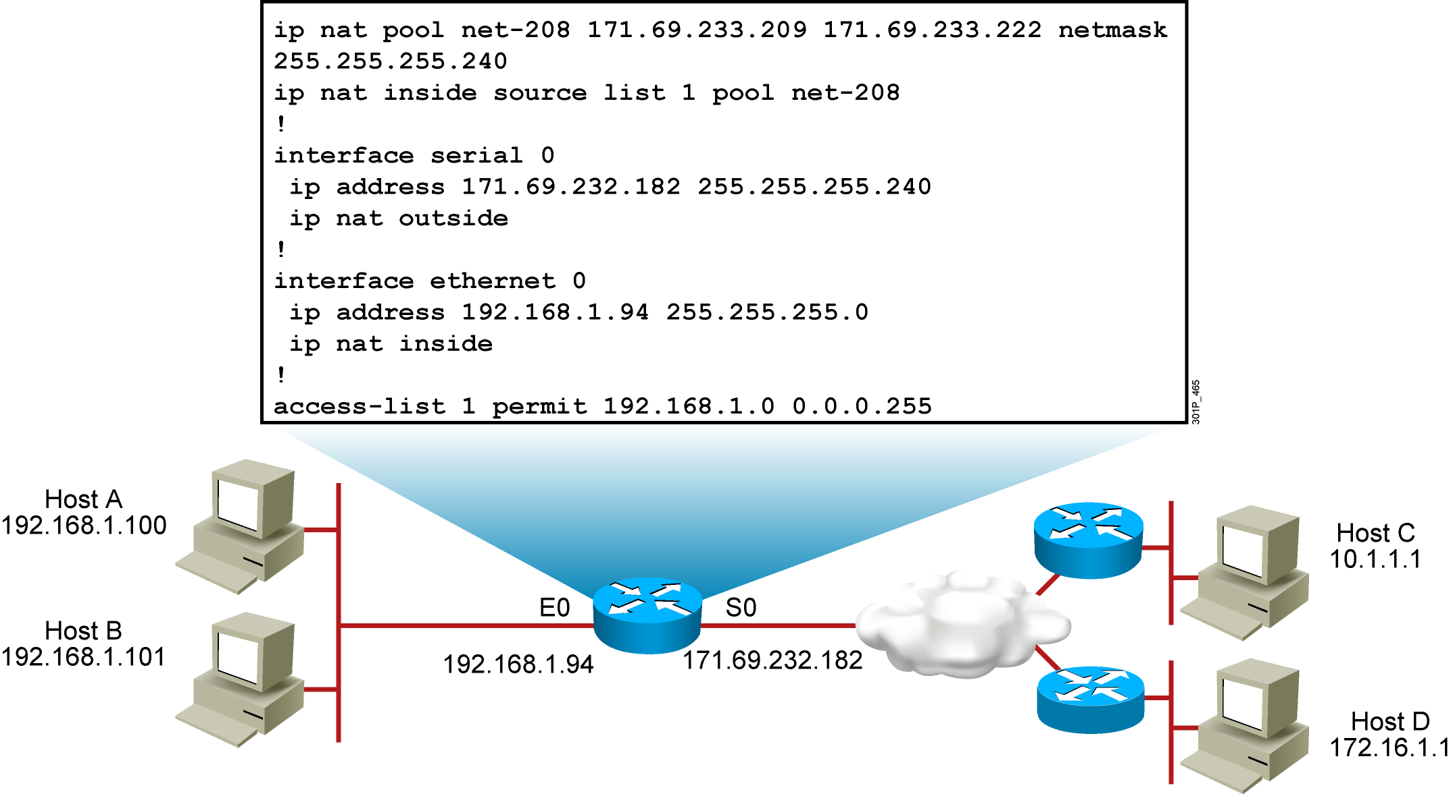
Dynamic Address Translation Example
RouterX# show ip nat translations
Pro Inside global Inside local Outside local Outside global
--- 171.69.233.209 192.168.1.100 --- ---
--- 171.69.233.210 192.168.1.101 --- ---

Slide 9
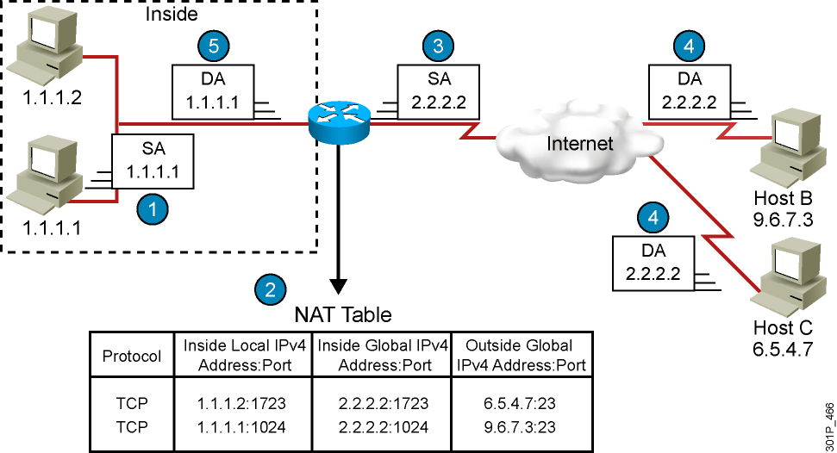
Overloading an Inside Global Address

Slide 10
Configuring Overloading
RouterX(config)# access-list access-list-number permit
source source-wildcard
Defines a standard IP ACL that will permit the inside local addresses
that are to be translated
RouterX(config)# ip nat inside source list
access-list-number interface interface overload
Establishes dynamic source translation, specifying the ACL that was
defined in the previous step
RouterX# show ip nat translations
Displays active translations

Slide 11
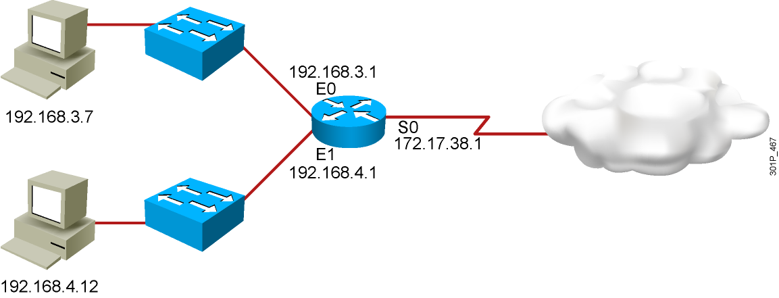
Overloading an Inside Global Address Example
hostname RouterX
!
interface Ethernet0
ip address 192.168.3.1 255.255.255.0
ip nat inside
!
interface Ethernet1
ip address 192.168.4.1 255.255.255.0
ip nat inside
!
interface Serial0
description To ISP
ip address 172.17.38.1 255.255.255.0
ip nat outside
!
ip nat inside source list 1 interface Serial0 overload
!
ip route 0.0.0.0 0.0.0.0 Serial0
!
access-list 1 permit 192.168.3.0 0.0.0.255
access-list 1 permit 192.168.4.0 0.0.0.255
!
RouterX# show ip nat translations
Pro Inside global Inside local Outside local Outside global
TCP 172.17.38.1:1050 192.168.3.7:1050 10.1.1.1:23 10.1.1.1:23
TCP 172.17.38.1:1776 192.168.4.12:1776 10.2.2.2:25 10.2.2.2:25

Slide 12
Clearing the NAT Translation Table
RouterX# clear ip nat translation *
Clears all dynamic address translation entries
RouterX# clear ip nat translation inside global-ip
local-ip [outside local-ip global-ip]
Clears a simple dynamic translation entry that contains an inside
translation or both an inside and outside translation
RouterX# clear ip nat translation outside
local-ip global-ip
Clears a simple dynamic translation entry that contains an outside
translation
RouterX# clear ip nat translation protocol inside global-ip
global-port local-ip local-port [outside local-ip
local-port global-ip global-port]
Clears an extended dynamic translation entry (PAT entry)

Slide 13
Translation Not Occurring:
Translation Not Installed in the Table
Verify that:
  There are no inbound ACLs that are denying the packets entry to the NAT router
  The ACL referenced by the NAT command is permitting all necessary networks
  There are enough addresses in the NAT pool
  The router interfaces are appropriately defined as NAT inside or NAT outside

Slide 14
Displaying Information with show and debug Commands
RouterX# debug ip nat
NAT: s=192.168.1.95->172.31.233.209, d=172.31.2.132 [6825]
NAT: s=172.31.2.132, d=172.31.233.209->192.168.1.95 [21852]
NAT: s=192.168.1.95->172.31.233.209, d=172.31.1.161 [6826]
NAT*: s=172.31.1.161, d=172.31.233.209->192.168.1.95 [23311]
NAT*: s=192.168.1.95->172.31.233.209, d=172.31.1.161 [6827]
NAT*: s=192.168.1.95->172.31.233.209, d=172.31.1.161 [6828]
NAT*: s=172.31.1.161, d=172.31.233.209->192.168.1.95 [23312]
NAT*: s=172.31.1.161, d=172.31.233.209->192.168.1.95 [23313]
RouterX# show ip nat statistics
Total active translations: 1 (1 static, 0 dynamic; 0 extended)
Outside interfaces:
Ethernet0, Serial2
Inside interfaces:
Ethernet1
Hits: 5 Misses: 0
…

Slide 15
Translation Occurring: Installed Translation Entry Not Being Used
Verify:
  What the NAT configuration is supposed to accomplish
  That the NAT entry exists in the translation table and that it is accurate
  That the translation is actually taking place by monitoring the NAT process or statistics
  That the NAT router has the appropriate route in the routing table if the packet is going from inside to outside
  That all necessary routers have a return route back to the translated address

Slide 16
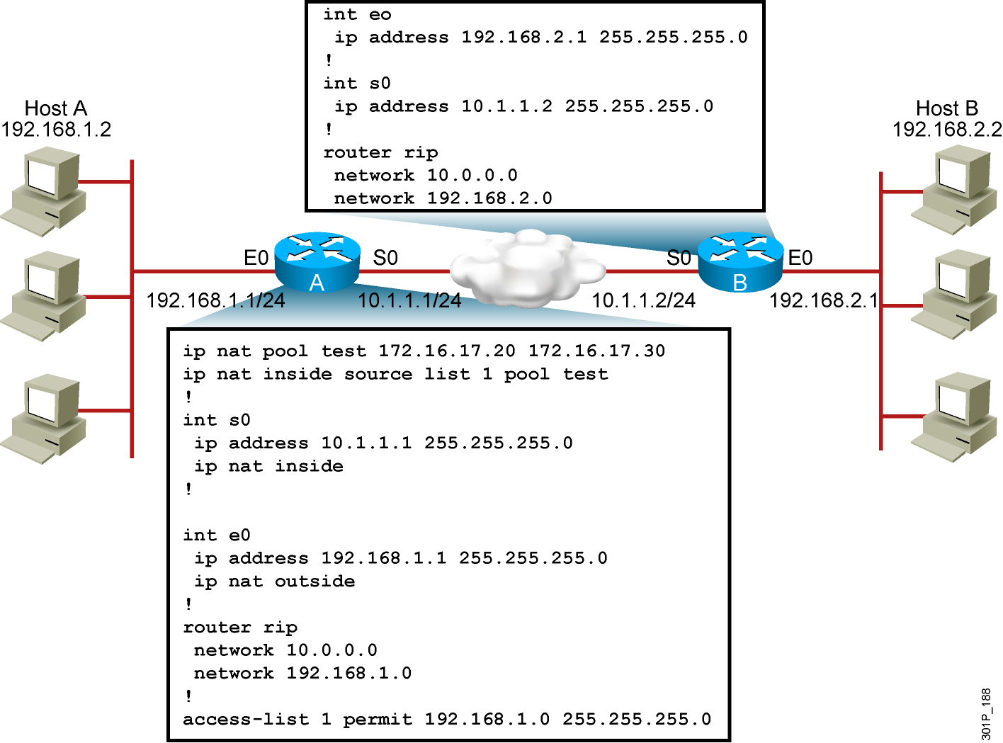
Sample Problem: Cannot Ping
Remote Host

Slide 17
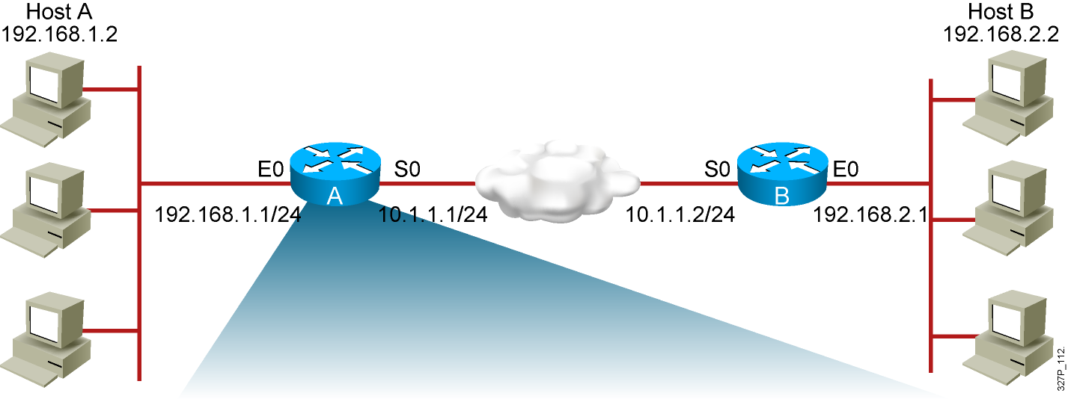
Sample Problem: Cannot Ping
Remote Host (Cont.)
RouterA# show ip nat translations
Pro Inside global Inside local Outside local Outside global
--- --- ---
--- --- ---
There are no translations in the table.

Slide 18
Sample Problem: Cannot Ping
Remote Host (Cont.)
RouterA# show ip nat statistics
Total active translations: 0 (0 static, 0 dynamic; 0 extended)
Outside interfaces:
Ethernet0
Inside interfaces:
Serial0
Hits: 0 Misses: 0
…
The router interfaces are inappropriately defined as NAT inside and NAT outside.

Slide 19
Sample Problem: Cannot Ping
Remote Host (Cont.)
RouterA# show access-list
Standard IP access list 20
10 permit 0.0.0.0, wildcard bits 255.255.255.0
Pings are still failing and there are still no translations in the table.
There is an incorrect wildcard bit mask in the ACL that defines
the addresses to be translated.

Slide 20
Sample Problem: Cannot
Ping Remote Host (Cont.)
RouterA# show ip nat translations
Pro Inside global Inside local Outside local Outside global
--- 172.16.17.20 192.168.1.2 --- ---
Translations are now occurring.
Pings are still failing.

Slide 21
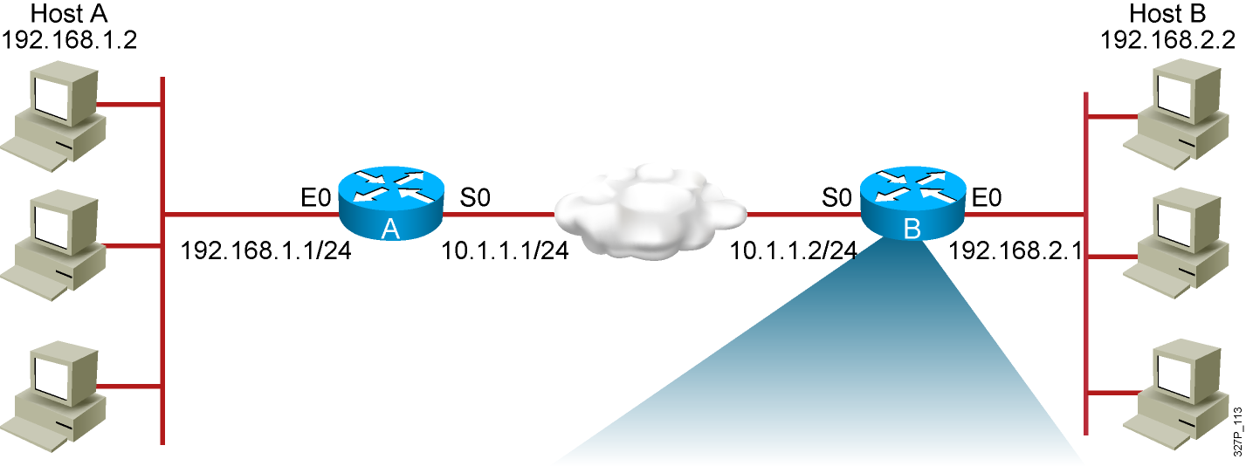
Sample Problem: Cannot Ping
Remote Host (Cont.)
RouterB# sh ip route
Codes: C - connected, S - static, R - RIP, M - mobile, B - BGP
Gateway of last resort is not set
10.0.0.0/24 is subnetted, 1 subnets
C 10.1.1.0/24 is directly connected, Serial0
192.168.2.0/24 is subnetted, 1 subnets
R 192.168.2.0/24 is directly connected, Ethernet0
192.168.1.0/24 is variably subnetted, 3 subnets, 2 masks
R 192.168.1.0/24 [120/1] via 10.1.1.1, 2d19h, Serial0
Router B has no route to the translated network address of 172.16.0.0.

Slide 22
Sample Problem: Cannot Ping
Remote Host (Cont.)
RouterA# sh ip protocol
Routing Protocol is "rip"
Outgoing update filter list for all interfaces is not set
Incoming update filter list for all interfaces is not set
Sending updates every 30 seconds, next due in 0 seconds
Invalid after 180 seconds, hold down 180, flushed after 240
Redistributing: rip
Default version control: send version 1, receive any version
Automatic network summarization is in effect
Maximum path: 4
Routing for Networks:
192.168.0.0
Routing Information Sources:
Gateway Distance Last Update
Distance: (default is 120)
Router A is advertising the network that is being translated, 192.168.1.0,
instead of the network address the router is translating into,172.16.0.0.

Slide 23
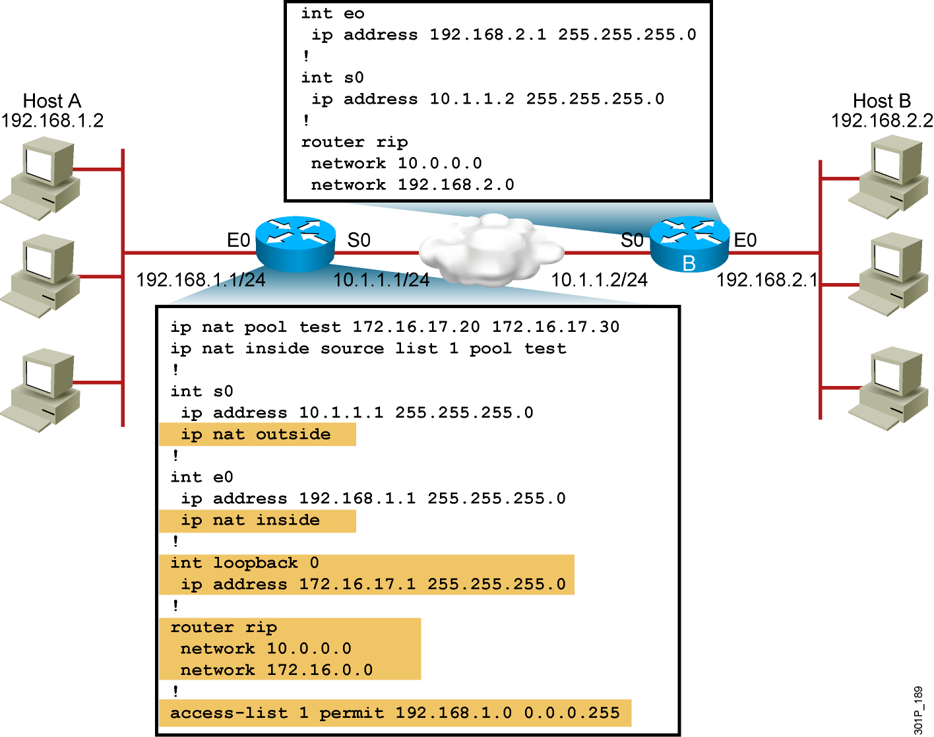
Solution: Corrected Configuration

Slide 24
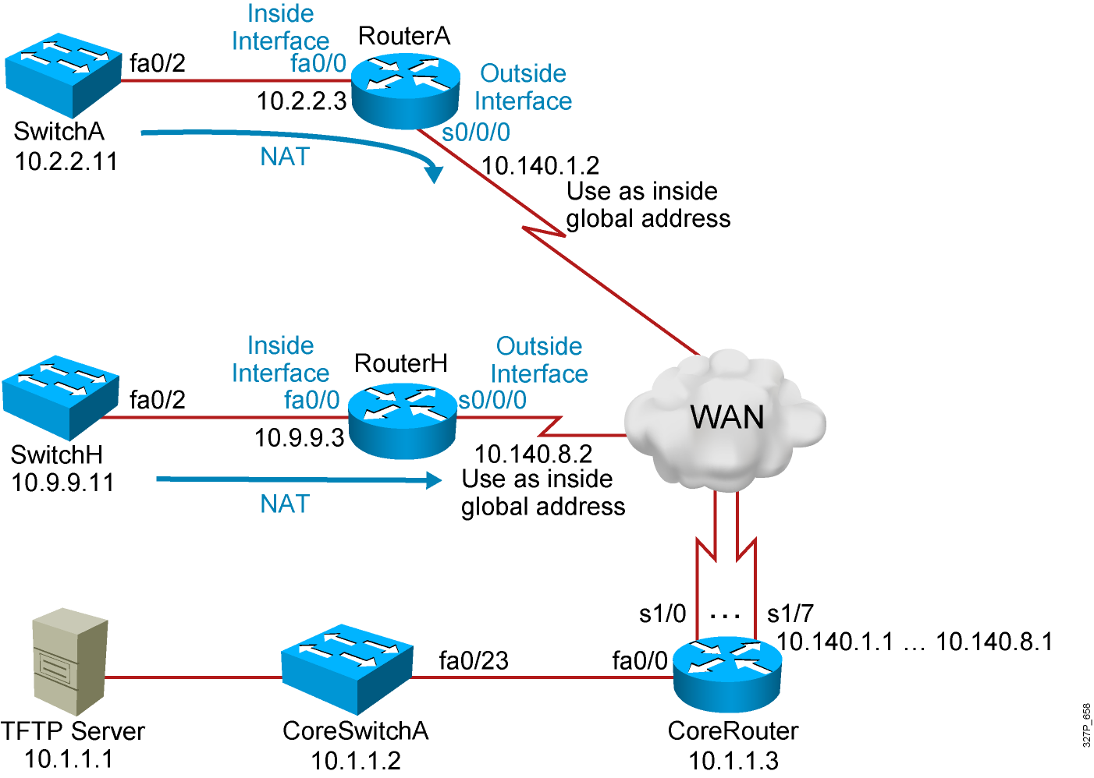
Visual Objective 7-1:
Configuring NAT and PAT
WG Router s0/0/0 Router fa0/0 Switch
A 10.140.1.2 10.2.2.3 10.2.2.11
B 10.140.2.2 10.3.3.3 10.3.3.11
C 10.140.3.2 10.4.4.3 10.4.4.11
D 10.140.4.2 10.5.5.3 10.5.5.11
E 10.140.5.2 10.6.6.3 10.6.6.11
F 10.140.6.2 10.7.7.3 10.7.7.11
G 10.140.7.2 10.8.8.3 10.8.8.11
H 10.140.8.2 10.9.9.3 10.9.9.11
Notes:
Lab 13 ACL
Note: Refer to the lab setup guide for lab instructions.

Slide 25



phamthaikhanh@gmail.com
This Photo by Unknown Author is licensed under CC BY-NC

